Slide 1
TRATTAMENTO ENDOSCOPICO DELLE COMPLICANZE CHIRURGICHE: MULTIPLI DEVICES MA POCA CHIAREZZA
Giovanni galasso
Gastroenterologia ed endoscopia
Pineta grande hospital
Castelvolturno (ce )

Slide 2
SOLUZIONI DI CONTINUO NELLE SLEEVE G. : LEAK
ASCESSO
POCA CHIAREZZA …….
LA QUASI TOTALITA’DEGLI STUDI SONO RETROSPETTIVI
DATI PREVALENTI SU SLEEVE GASTRECTOMY
DATI PREVALENTI SUGLI STENT MA «CAOTICI»
AL CENTRO LA METODICA
….bassa qualità scientifica…
DATI VALUTABILI
Efficacia
Complicanze
Costo medio
Migrazione (stent)
DATI NON VALUTABILI
Caratteristiche chirurgiche del paziente
Timing intervento - diagnosi
Timing diagnosi – procedura endoscopica
Timing alimentazione

Slide 3
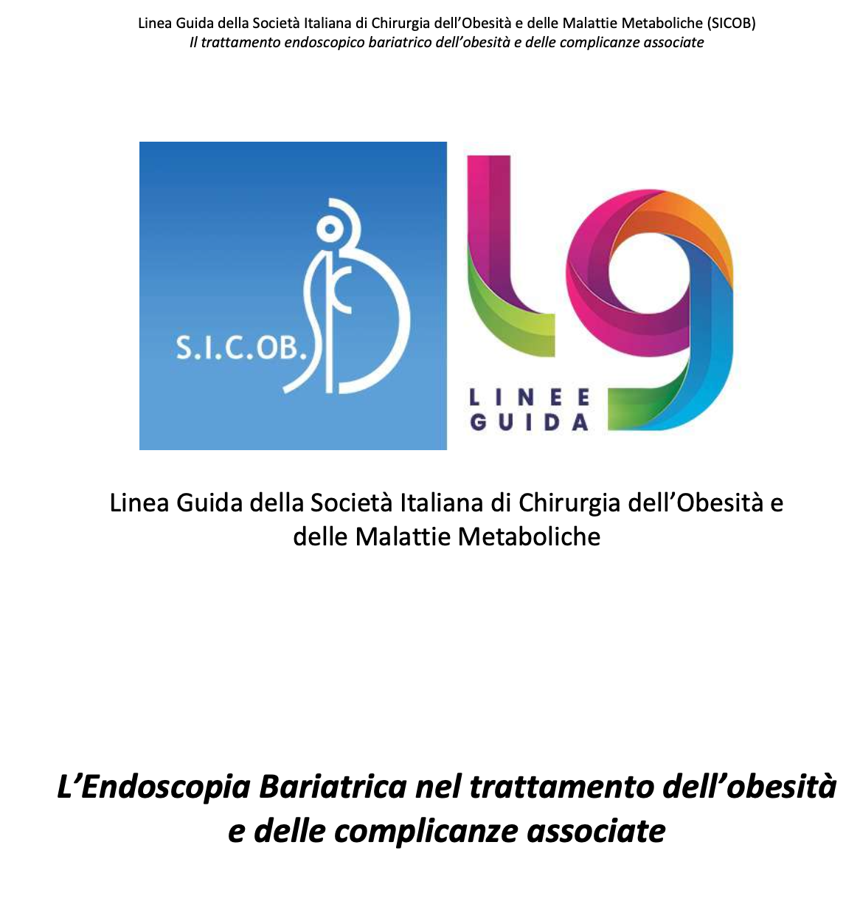
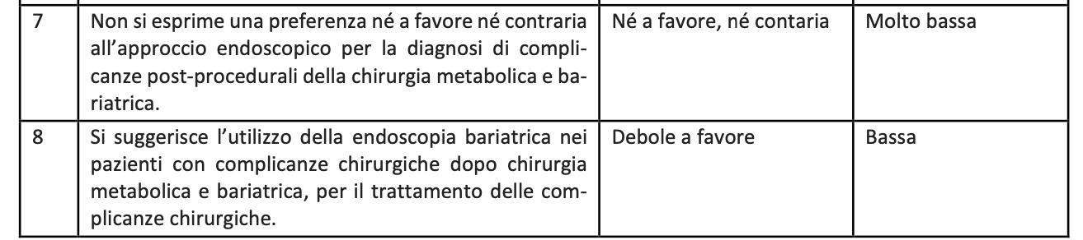
LINEE GUIDA

Slide 4

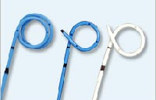
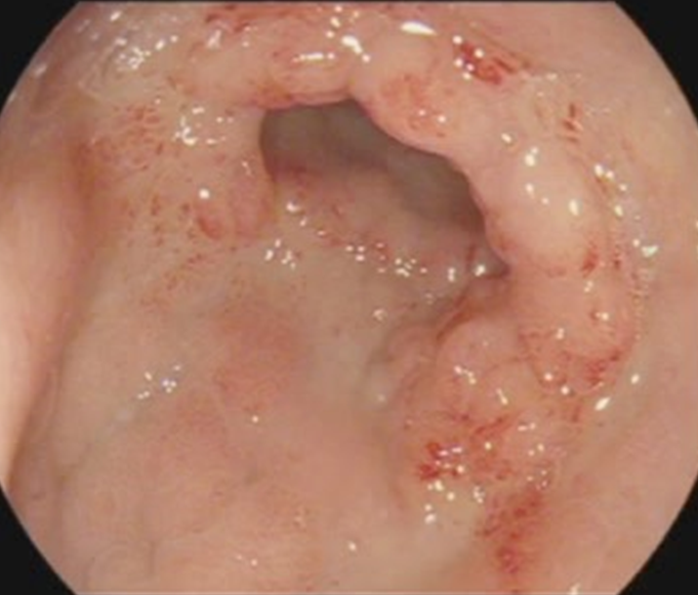
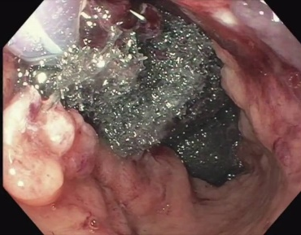
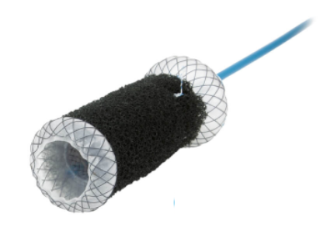
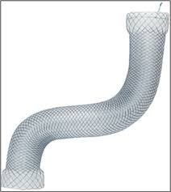
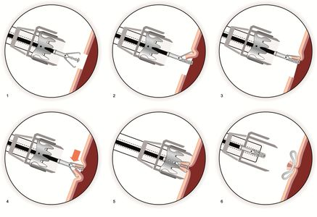
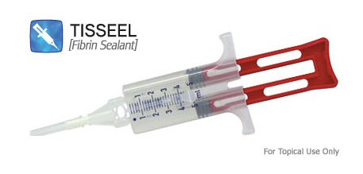
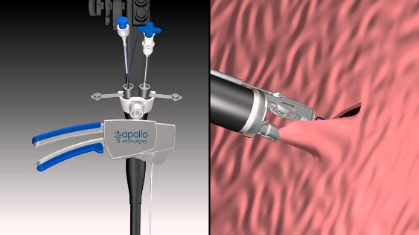
LEAK : TRATTAMENTO ENDOSCOPICO
DRENARE
ASPIRARE/COPRIRE
COMBINAZIONE DI PIU’ TECNICHE
COPRIRE
CICATRIZZARE
CHIUDERE

Slide 5
TRATTAMENTO | EFFICACIA | COMPLICANZE GLOBALI
PCSEMS (n=200) | 85% | 28%
MEGASTENT (n=100) | 84% | 30%
PIGTAILS (n=330) | 93% | 9%
OTSC esclusivo (n=45) | 60% | 8%
Overstitch (n=31) | 27% | 0%
OBTA 2018 personal data
25 lavori
n=500

Slide 6
429: 56 lavori
N: 2896

Slide 7
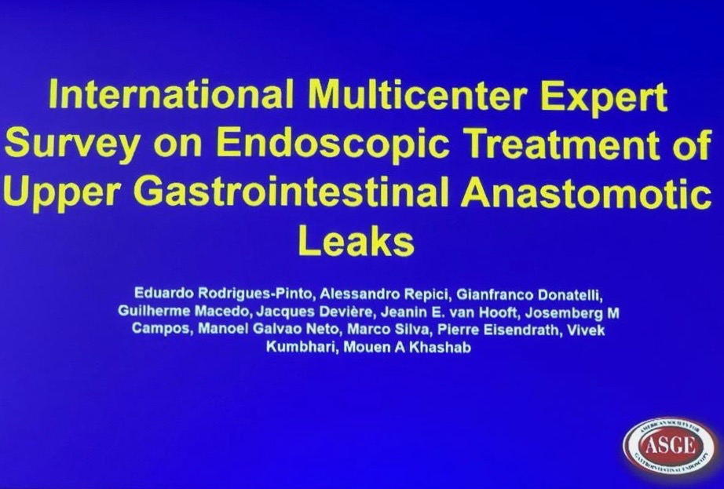
SURVEY - D.D.W. MAY 2019

Slide 8
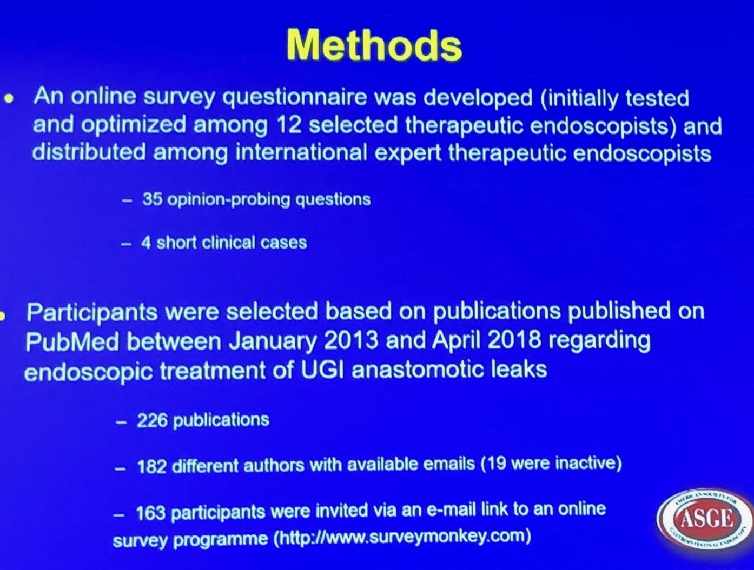
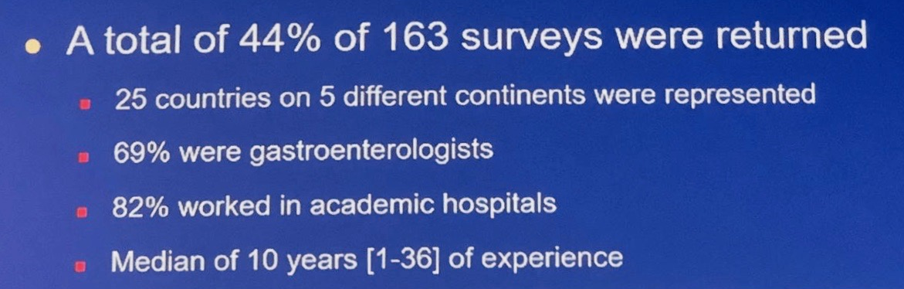
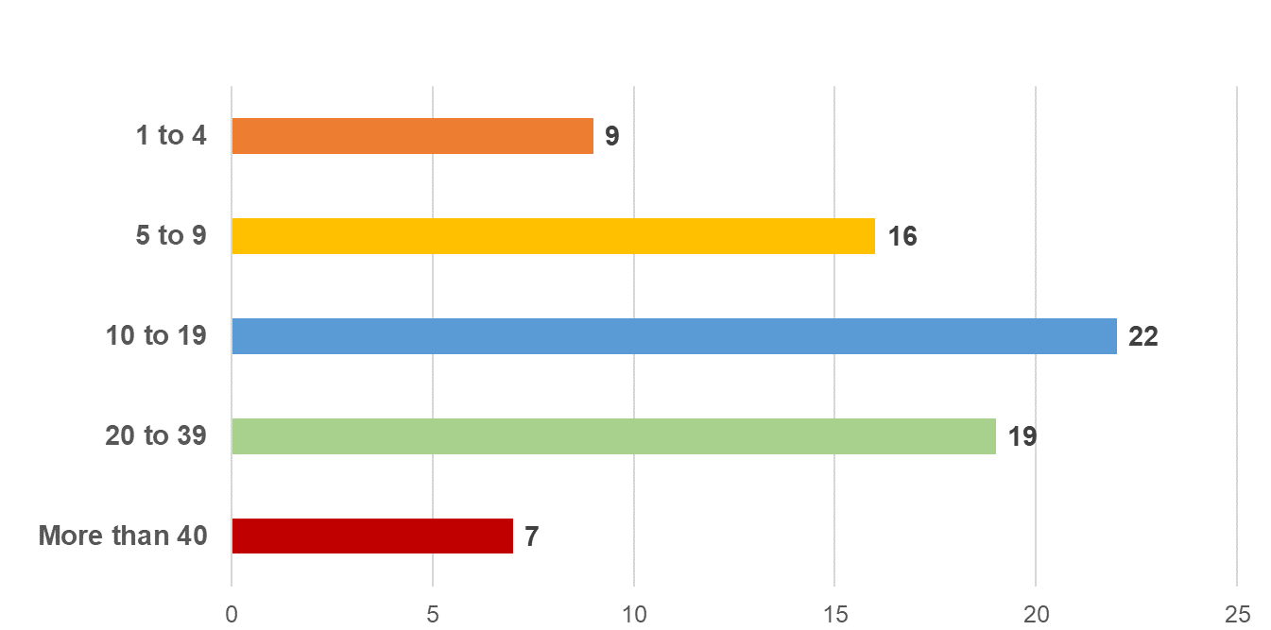
PARTECIPANTI

Slide 9
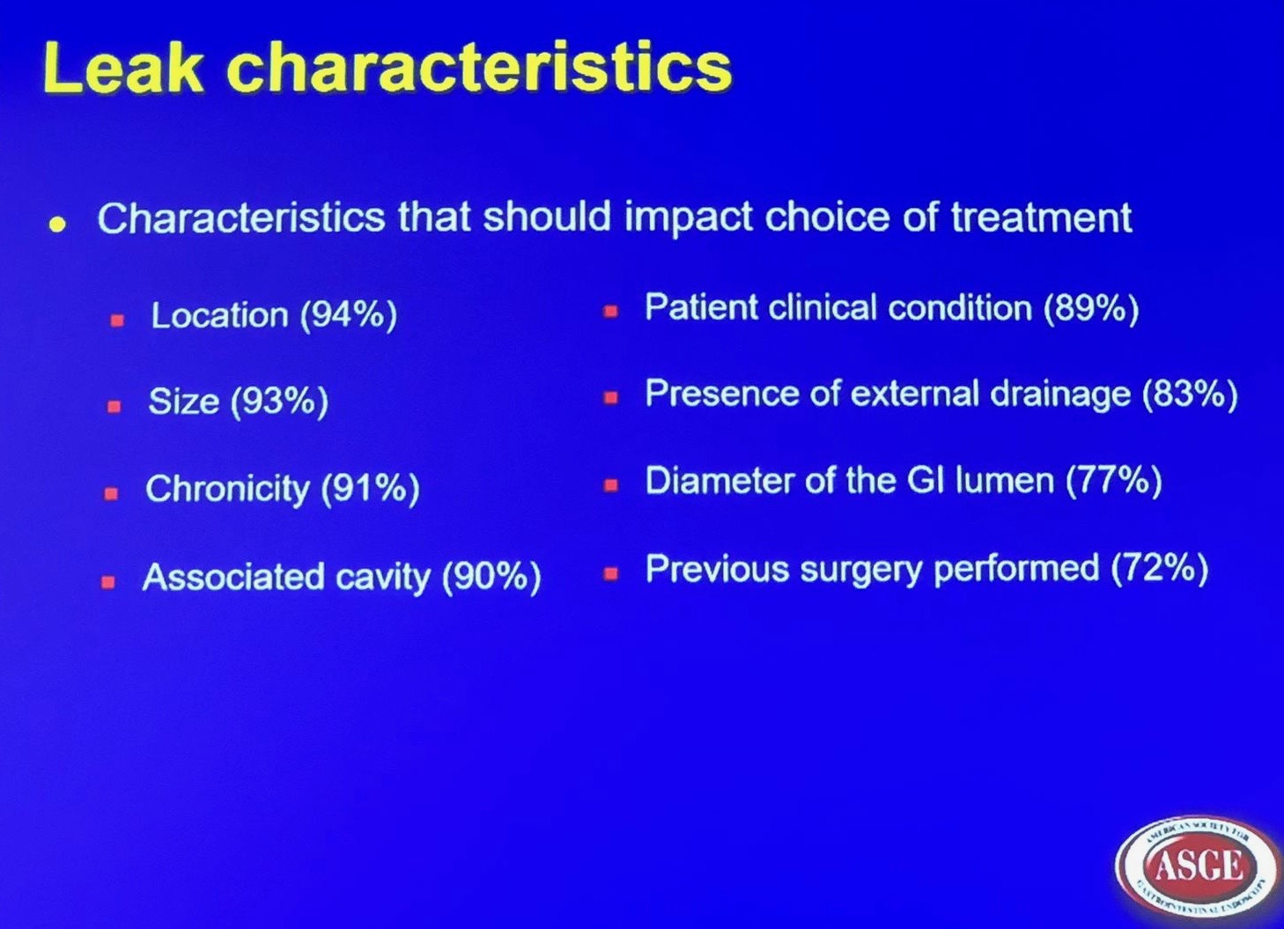
QUALI CARATTERISTICHE MODIFICANO LE SCELTE TERAPEUTICHE

Slide 10
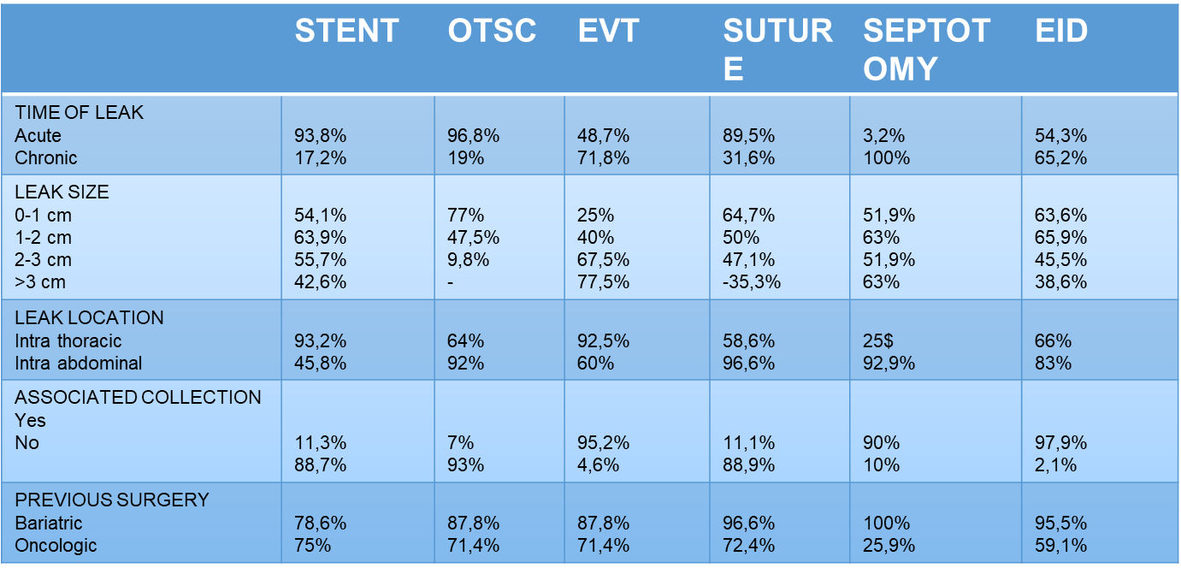
STRATIFICAZIONE DEL PAZIENTE
DDW - 2019
TECNICA

Slide 11
. A patient with a bariatric surgery leak is not just another case on the daily endoscopy list, nor is there a standardized approach that can be simply applied to all patients. The endoscopist must be aware that there is more to it than just “plugging the defect”; it is the assurance of a permanent closure that is the ultimate goal. T
This requires the endoscopist to adopt a wider angle view of the patient, appreciating that there are multiple factors pertaining to successful leak closure, the
most basic of which are adequate drainage, the absence of distal obstruction, ensuring the fistulous track is not epithelialized, and maintenance of adequate nutrition.
To date, there is still no agreement on the “optimal” endoscopic technique for the management of leaks, and probably there never will be. This is due to the basic fact that not all leaks are the same and numerous factors contribute to the persistence of a leak.

Slide 12
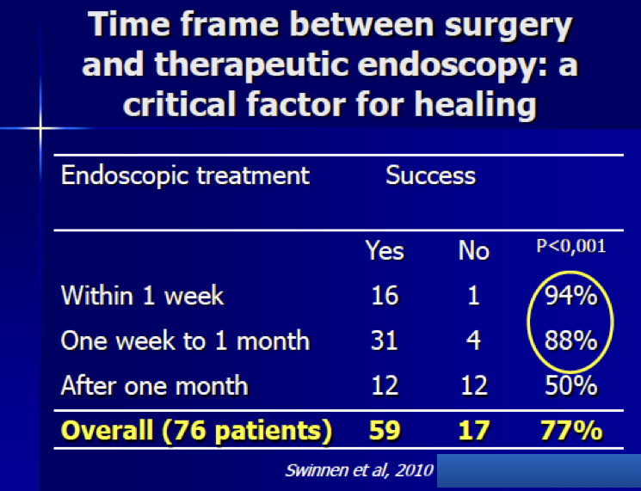

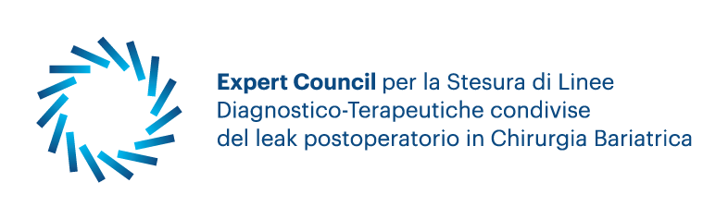
1
QUANDO L’ENDOSCOPIA
EGDS
SEMPRE E PRIMA POSSIBILE
MAI NESSUNA CONTROINDICAZIONE

Slide 13
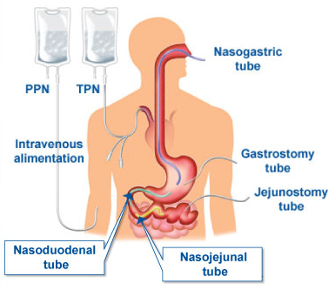
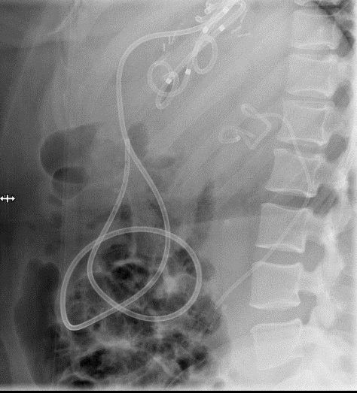
2
SUPPORTO NUTRIZIONALE
10-12 Fr
IL SUPPORTO NUTRIZIONALE E’ FONDAMENTALE PER EVITARE IL CATABOLISMO PROTEICO E FAVORIRE LA GUARIGIONE.

Slide 14
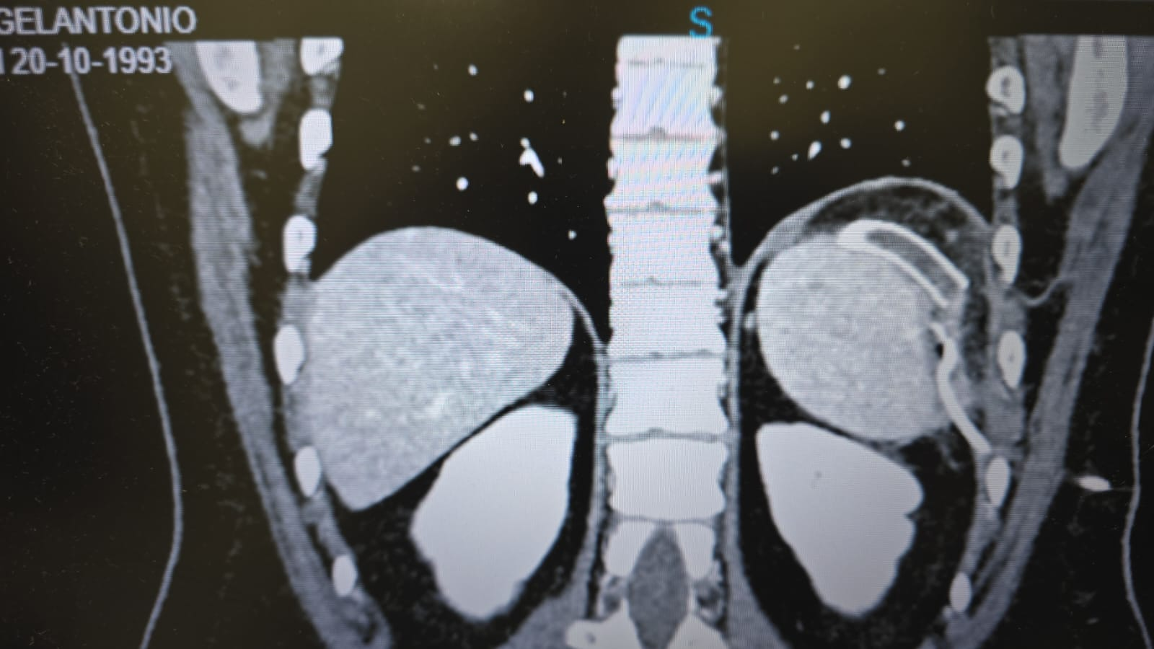
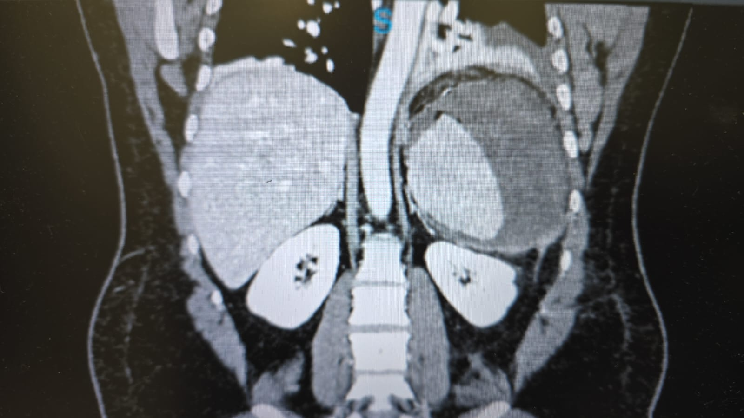
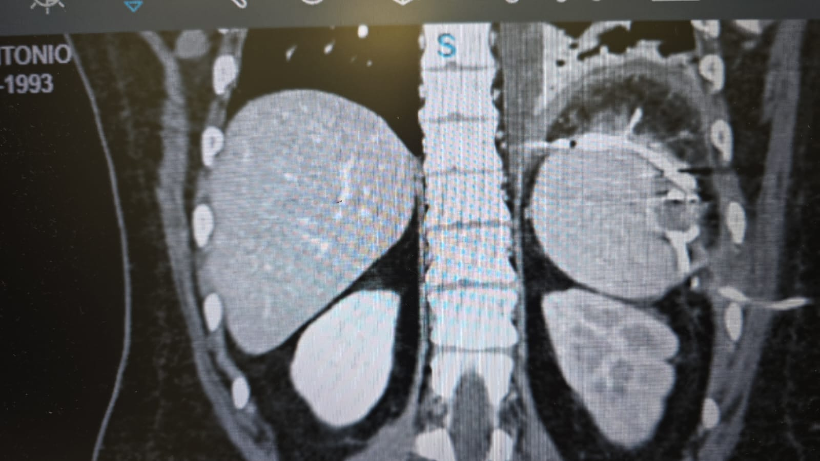
3
VALUTAZIONE RADIOLOGICA
PRE
POST

Slide 15
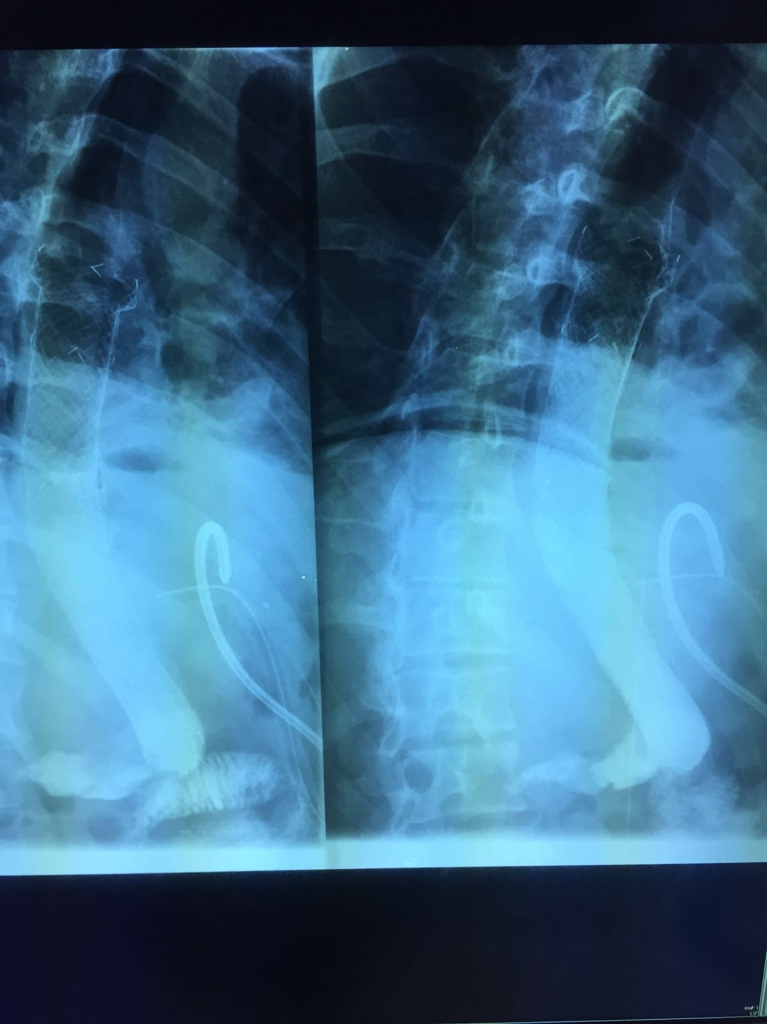
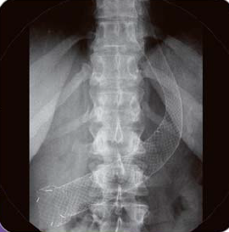
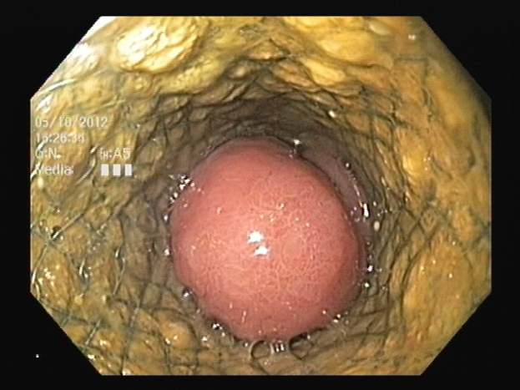
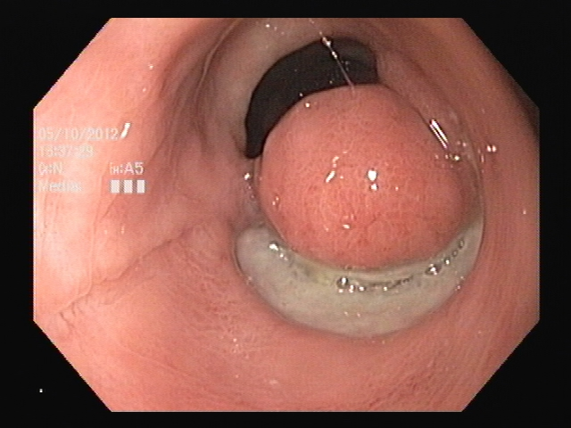
4
VALUTAZIONI PERSONALI : STENT
EVENTI ATTESI:
- Alimentazione orale controindicata
Nausea , vomito
Rigurgidi
Dolori addomino toracici
Ingrowth
Decubito
COMPLICANZE:
- Migrazione??? -> 5-67%
- Perforazione
- Emorragia
- Fistolizzazione
RELATIVAMENTE FACILE ESECUZIONE
VANTAGGI ESCLUSIVI
CORREZIONI STENOSI
CORREZIONI NEI CASI DI DEFLUSSO PREVALENTE DI SALIVA
Rare

Slide 16
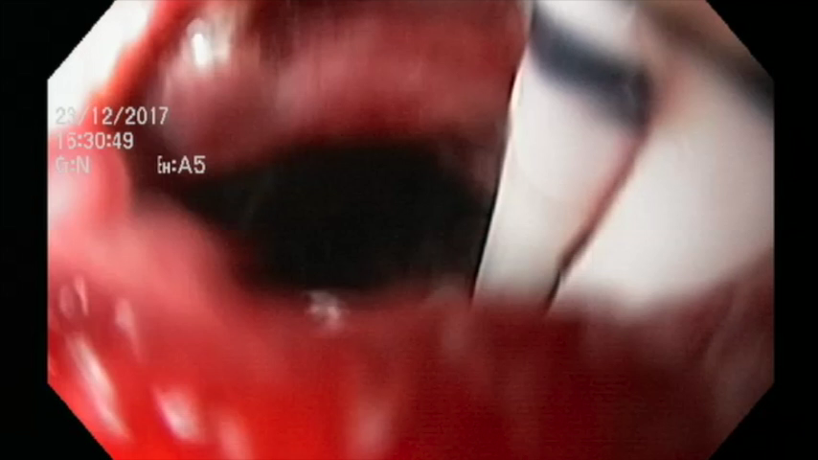
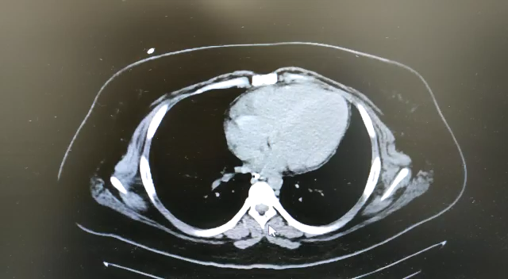
4
VALUTAZIONI PERSONALI : EID
NECESSARIA ESPERIENZA CONSOLIDATA DI ENDOSCOPIA IN SALA RADIOLOGICA
VANTAGGI ESCLUSIVI
* COADIUVARE O VICARIARE IL DRENAGGIO CHIRURGICO / RADIOLOGICO
* ESEGUIBILE A MEZZO PROTESI /SONDINI
* E’ LA PROCEDURA MEGLIO TOLLERATA
NESSUNA LIMITAZIONE ALLA N.E.
COSTI MOLTO CONTENUTI
LIMITI
VALUTAZIONE DELLE PRESSIONI
CONTEMPORANEA STENOSI
DIMENSIONI DELLA CAVITA’
COMPLICANZE
DISLOCAMENTO
PERFORAZIONE VISCERALI
EMORRAGIE

Slide 17
Eric J. Vargas, MD Barham K. Abu Dayyeh, MD, MPH, FASGE
Division of Gastroenterology and Hepatology Mayo Clinic, Rochester, Minnesota, USA
The second principle: For subacute or chronic leaks
with an organized walled-off collection, internal drainage
with 2 or more double-pigtail plastic stents is effective
both clinically and from a cost perspective. Concurrent
endoscopic necrosectomy can be performed, if feasible, to
clean and remove necrotic infected material from within
the cavity and enhance drainage. Managing a downstream stenosis, twist, or kink within the sleeve that creates an unfavorable pressure gradient in this situation is critical to enhance drainage and resolution.
The first principle: In a patient unstable, with an acute leak and systemic inflammatory response syndrome or peritonitis, surgical washout with or without drain placement is mandatory and should not be delayed. Concurrent endoscopic management with
placement of a covered or partially covered metal stents
is effective in this setting before the formation of an organized collection
The third principle: Have a high index of suspicion for special situations in which neither endoscopic closure nor
drainage alone is effective. These special situations require referral to a tertiary bariatric center with both endoscopic and surgical expertise to manage.
GASTROINTESTINAL ENDOSCOPY Volume 87, No. 2 : 2018

Slide 18
Grazie

